Slide 1
Comparing Machine Learning Algorithm to Predict Heart Attacks
Halé Kpetigo / hale.kpetigo@gmail.com 03/19/2021
NIH / FAES – 509 / Spring 2021

Slide 2
Can heart attacks be predicted?
Heart diseases is the leading cause of death in the US.
Condition of a heart disease is often silent and not diagnosed
This leads to heart attacks, arrhythmia or heart failure.
If we can diagnose at risk population from safe populations we could save lives

Slide 3
How can we predict?
Identify risk factor for heart attack
Identify dataset with risk factor information
Use unsupervised machine learning algorithm to classify the populations
Compare the different unsupervised approaches. What information to they provide?
Use a supervised approach to predict condition
Measure and compare each supervised approach

Slide 4
Risk factors
High blood pressure
High cholesterol
Smoking
Diabetes
Obesity
Unhealthy diet
Physical inactivity
Excessive use of alcohol

Slide 5
Identified Dataset
Features | Description
Age | Age of patient in years
Sex | Sex of patient (1 = male; 0 = female)
cp | Chest pain type (4 values)
trestbps | Resting blood pressure
chol | Serum cholesterol in mg/dl
fbs | Fasting blood sugar > 120 mg/dl
restecg | Resting electrocardiographic results (values 0,1,2)
thalach | Maximum heart rate achieved
exang | Exercise induced angina
oldpeak | Oldpeak = ST depression induced by exercise relative to rest (ECG)
slope | The slope of the peak exercise ST segment (ECG)
ca | Number of major vessels (0-3) colored by flourosopy
thal | Thalassemia: 0 = normal; 1 = fixed defect; 2 = reversible defect
target | 0= less chance of heart attack 1= more chance of heart attack
About data source: This database contains 76 attributes, but all published experiments refer to using a subset of 14 of them. Ref: https://archive.ics.uci.edu/ml/datasets/heart+disease
Dataset used – Cleveland only:
https://www.kaggle.com/johnsmith88/heart-disease-dataset
Similar dataset – All:
https://www.kaggle.com/nareshbhat/health-care-data-set-on-heart-attack-possibility

Slide 6
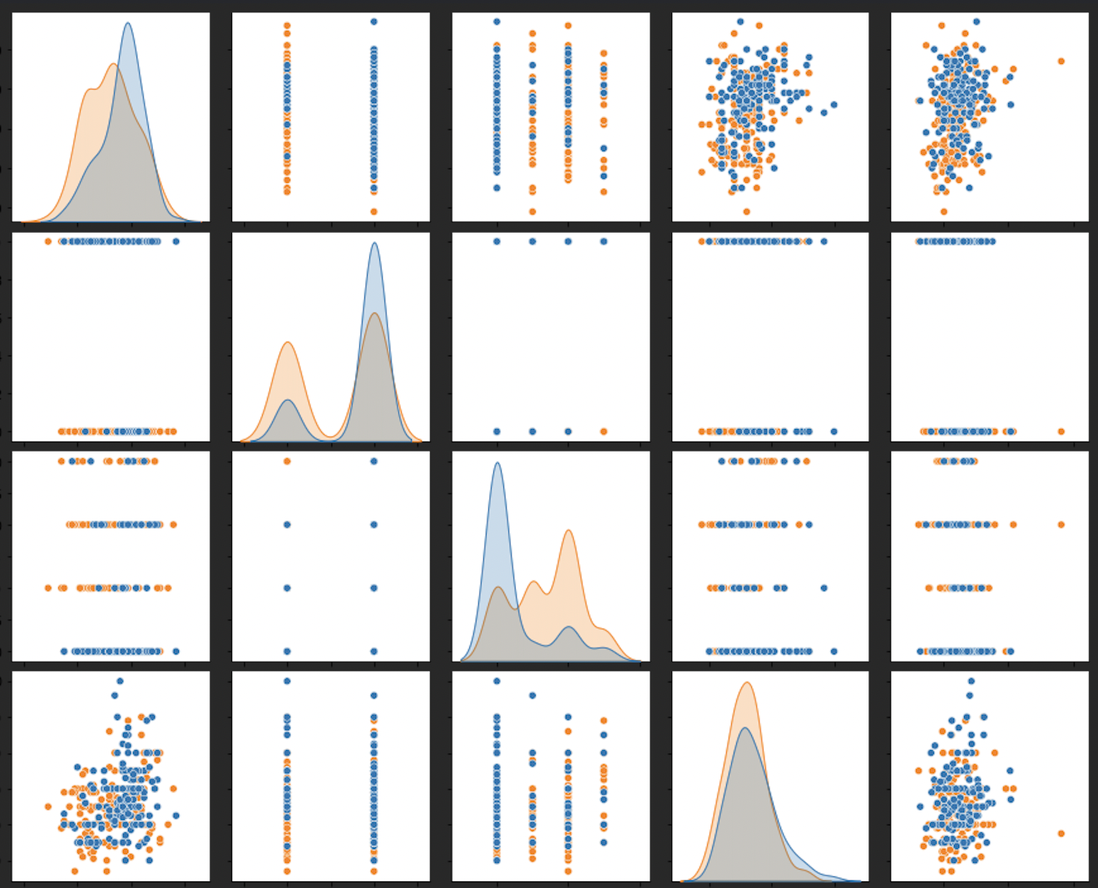
Data analysis – Pair Plot
Legend:
Blue: less chance of heart attack
Orange: more chance of heart attack
Pair plot shows relationship between the features of the dataset.
We can observe that pairs of the features that have a non continuous value (i.e. sex or cp) the clusters are not globular but instead linear. Each line representing the male or female for sex or each level of chest pain for cp.
From the diagonal distribution plot, we can observe that at risk population has a shorter life expectancy.
We can also observe that our dataset has less women than men, but of the studied women population, women are more at risk compared to the men within their studied population.
age
sex
cp
trestbps
age
sex
cp
trestbps
chol

Slide 7
Unsupervised Approach – K-means
K-Means helped identify 3 clusters
Elbow confirms that the optimal number of cluster is 3
Optimal number of clusters is 3

Slide 8
Unsupervised Approach – Hierarchical clustering
Optimal number of clusters is 2
Using the optimal number of clusters recommended by Elbow (2) we notice a dominant population with 108 record. It would be interesting to analyze that population to see the particularities of the features present in that population as opposed to the other groups.

Slide 9
Unsupervised Approach – Density clustering
Number of clusters: 3
Using all features:
Max accuracy 0.5478547854785478 with model DBSCAN(eps=1.1, min_samples=1)
Removing sex and age:
Max accuracy 0.6039603960396039 with model DBSCAN(eps=0.8, min_samples=6)
Accuracy is slightly improved by ignoring sex and age. Those two features may have been overfitting the model

Slide 10
Comparing Unsupervised approach
Algorithm | # Clusters
K-MEANS | 3
Hierarchical Clustering | 2
Density Clustering | 3
K-MEANS and Density Clustering identified 3 clusters when in fact we should be expecting 2 clusters
It would be interesting to analyze the data to have better insight in the similarities that exists within each population
I would also be interested in further analyzing these algorithms with a larger set of data to see the impact on the number of clusters identified

Slide 11
Supervised - SVM
PREDICTION ACCURACY 0.8150273224043716

Slide 12
Supervised – Decision Tree
Decision Tree Dataset size: 303
Accuracy Score on train data: 1.0
Accuracy Score on test data: 0.77
Accuracy Score on train data: 0.7635467980295566
Accuracy Score on the test data: 0.75
Dataset size: 1025
Accuracy Score on train data: 1.0
Accuracy Score on test data: 0.9823008849557522
Accuracy Score on train data: 0.8833819241982507
Accuracy Score on the test data: 0.8584070796460177

Slide 13
Supervised – Gaussian Naive Bayes
Gaussian NB
Dataset size: 303
Accuracy Score on train data: 0.8522167487684729
Accuracy Score on test data: 0.8
Gaussian NB
Dataset size: 1025
Accuracy Score on train data: 0.8338192419825073
Accuracy Score on test data: 0.8141592920353983

Slide 14
Comparing supervised approach
Algorithm | Accuracy (303) | Accuracy (1025)
SVM | 81% | 84%
Decision Tree | 75% | 98%
Bayesian – Gaussian Naïve Bayes | 80% | 81%
The performance of the 3 algorithms are comparable ranging from 75% to 98%.
SVM performed better on a larger data set
We have also observed that SVM performance improved on the smaller dataset after being trained on a larger training set
Decision Tree offered the most accuracy on a larger dataset, and performed the poorest on a smaller dataset. This may be due to overfitting.
Gaussian Naïve Bayes remained the most consistent across dataset sample size.
Algorithm | Accuracy (303) on (1025) trained
SVM | 83%
Decision Tree | 75%
Bayesian – Gaussian Naïve Bayes | 80%

Slide 15
References
Source code: https://github.com/halekpetigo/BIOF509
Data Description: https://archive.ics.uci.edu/ml/datasets/heart+disease
Data used: https://www.kaggle.com/johnsmith88/heart-disease-dataset
Data used: https://www.kaggle.com/nareshbhat/health-care-data-set-on-heart-attack-possibility

Slide 16
Questions?
Thank you!

